Slide 1
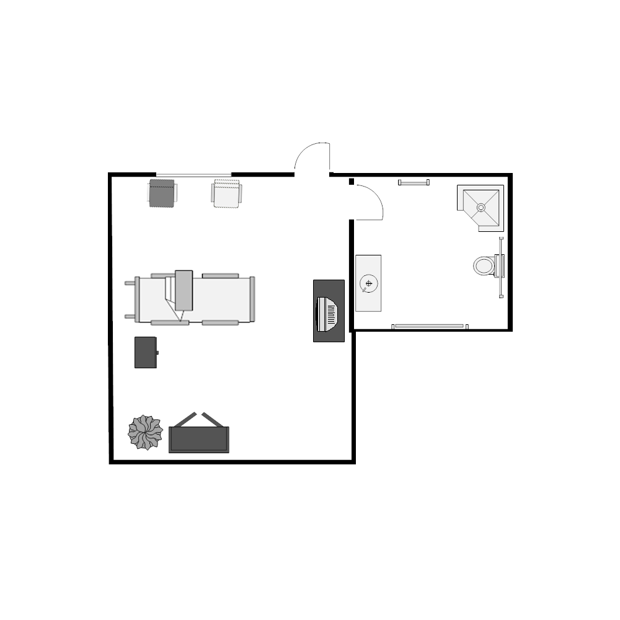
Deaf
Patient
Deaf
Spouse
Deaf
Terp
Hearing Terp
Doctor

